Slide 1


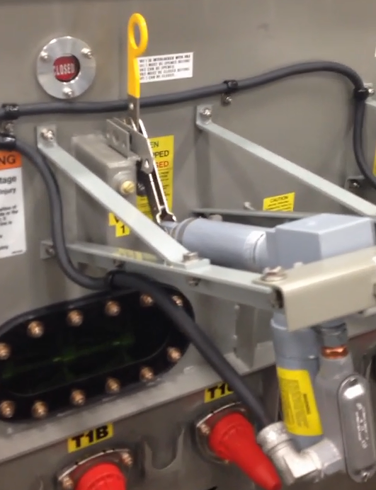
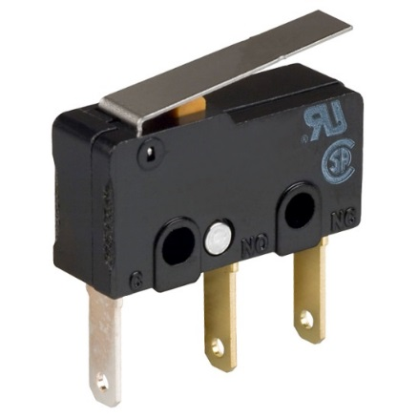
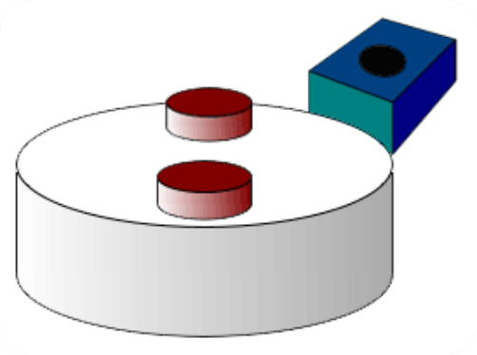

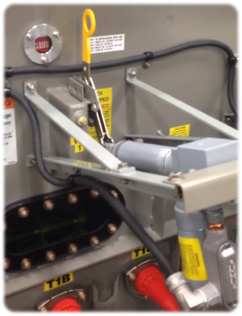
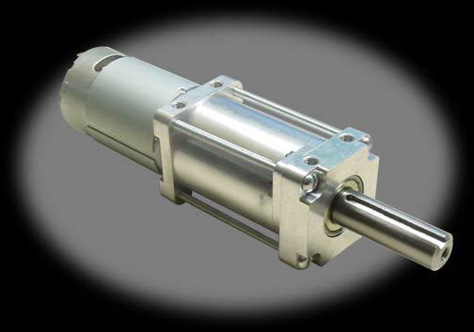
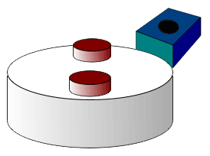
Motor Operator for VFI Switchgear
Theodore Beyene, Samuel Bucior, Jason Carney, Arthur Eichelberger
Position Sensing
Shaft Actuation
Old: Limit switch
Hall effect
Potentiometer
Old: Linear Actuator
New: Gearmotor
Price | $50 | $10 | $10
Lifetime | Great | Infinite | Good
Setup | Manual | By design | Either
Compatibility | Either | Two designs | Either
$1000 | Price | $300
Remove pin | Manual operation | Yes
Sticks out | Space needed | Minimal

