Slide 1
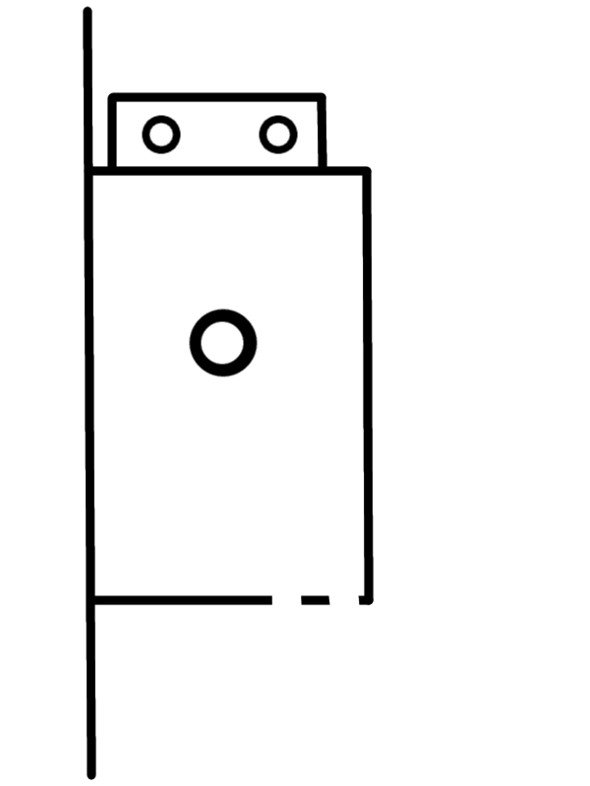
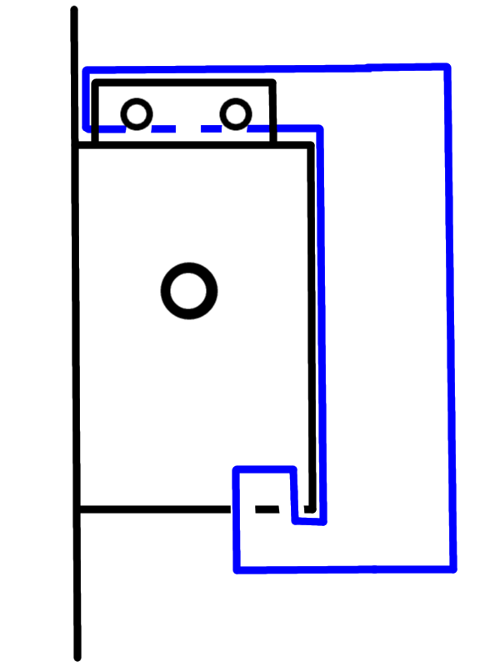
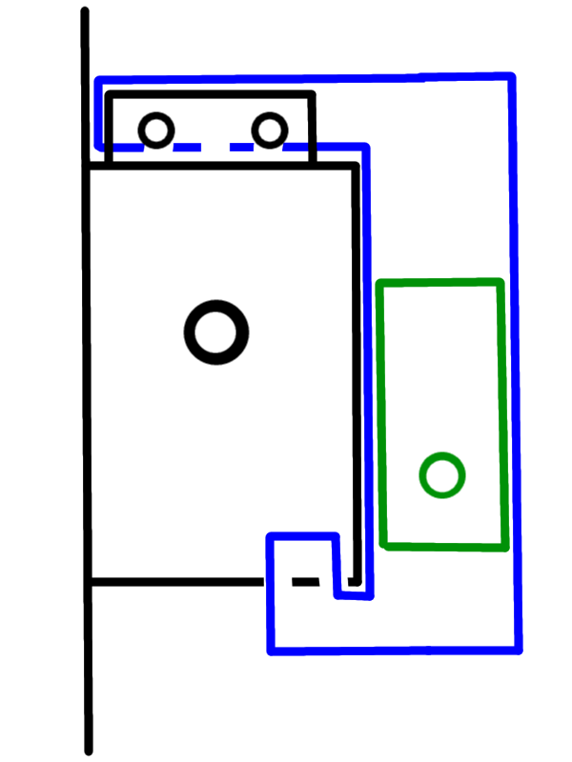
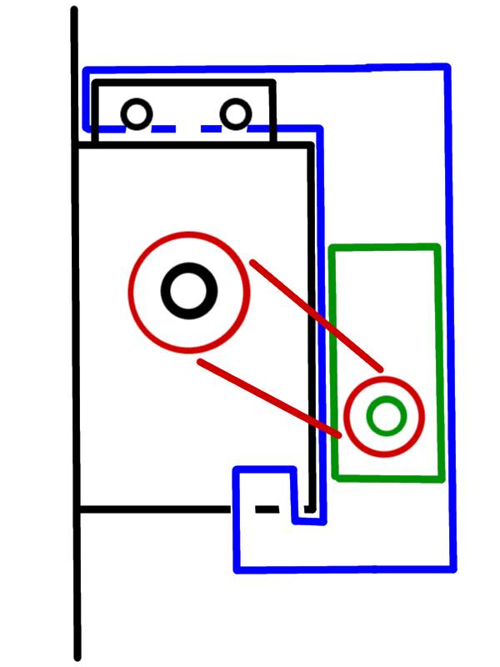

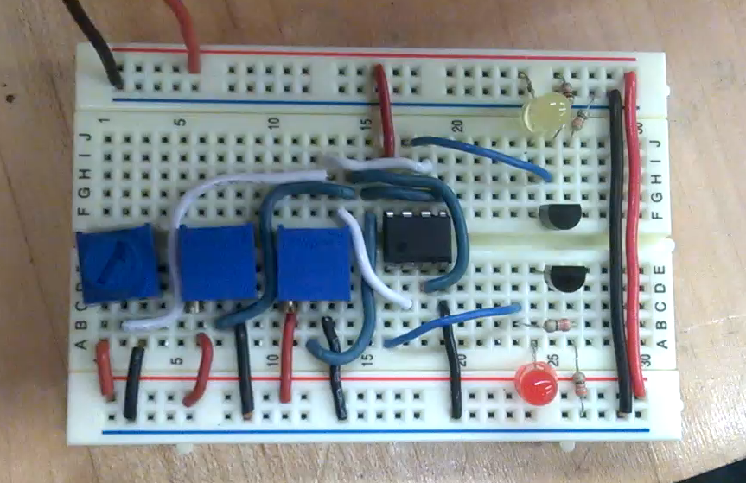
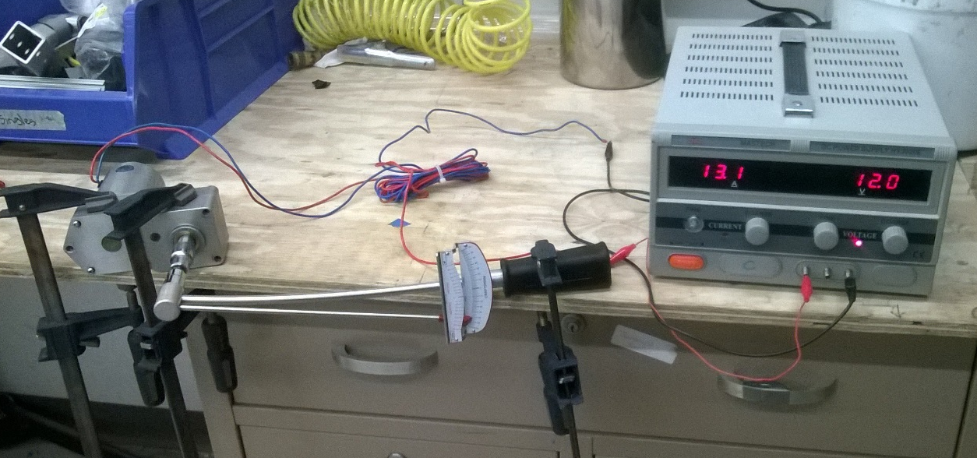
Motor Operator for VFI Switchgear
Theodore Beyene, Samuel Bucior, Jason Carney, Arthur Eichelberger
Position Sensing
Shaft Actuation
Complete | To Do:
Parts obtained | Attachment
Proof of concept | Motor control: MOSFETS
Complete | To Do:
Motor testing | 3D modeling
Chain/sprockets ordered | Manufacture/Assemble
Frame concept | Testing

