Slide 1
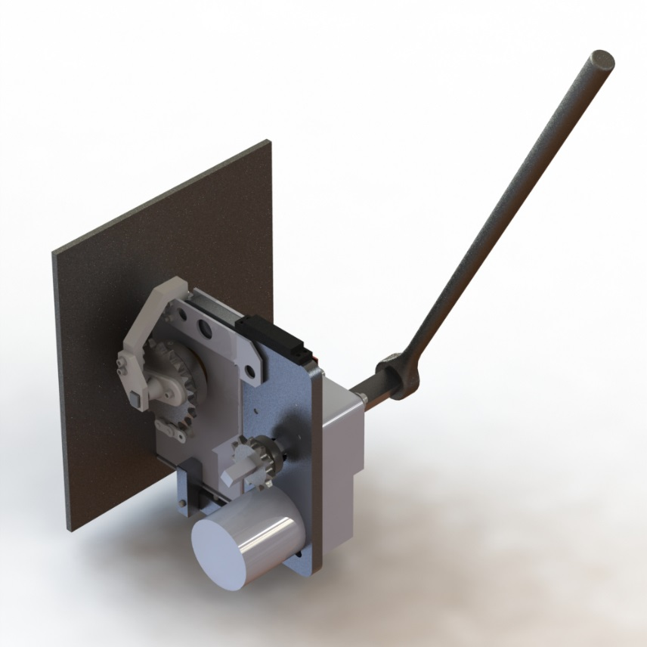
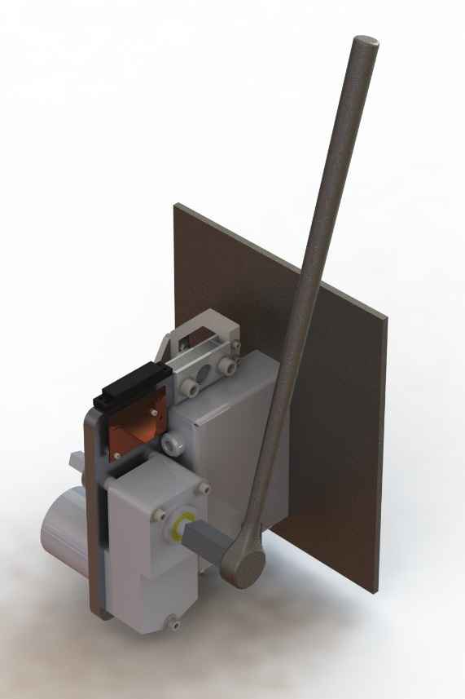


Motor Operator for VFI Switchgear
University of Pittsburgh: Theodore Beyene, Samuel Bucior, Jason Carney, Arthur Eichelberger
Eaton:
John Guldan

Slide 2


Background
=
Vacuum Fault Interrupter (VFI) Switchgear
Public domain
Public domain
Public domain

Slide 3
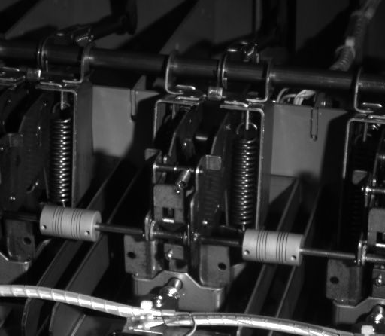
Background
Left: Slow motion “tripped” response
How it works:
Powerful springs are tensioned, storing energy.
The springs open the circuit extremely quickly.
Tensioning the springs requires high torque (up to 60ft-lb).
Public domain

Slide 4
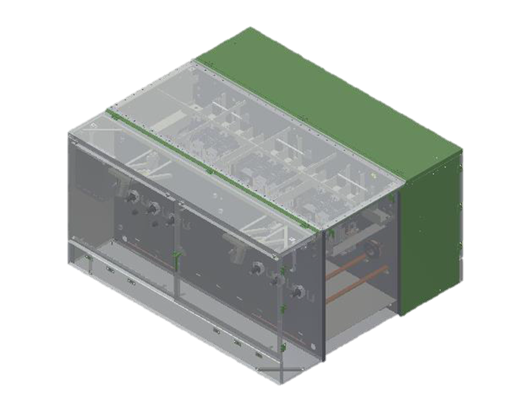
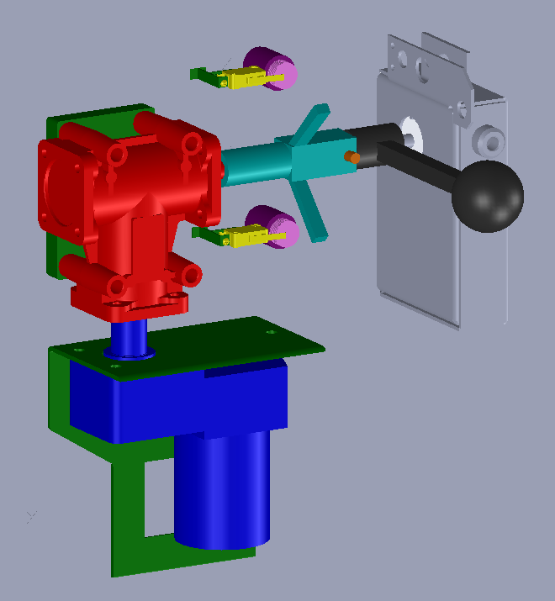
Background
Original design: $1000
Last year’s design: $450
Goal: Use an actuator rather than a person to flip the switchgear
Final Goal: Under $400

Slide 5
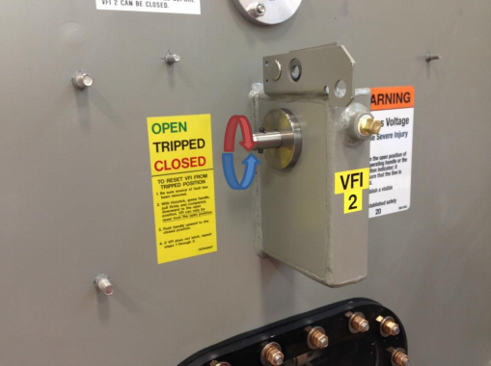
Requirements
Minimum Requirements
Provide 60ft-lb of torque
Operate on 24V input
Minimum speed of 4 RPM
Less than 2° overtravel
Under $400
Stretch Goals
Manual operation without the use of a pin
Use the original handle
Within 4” of all sides of switchgear case
Configurable to work with multiple angles of travel

Slide 6
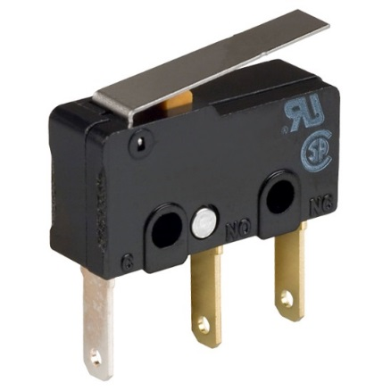
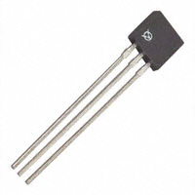
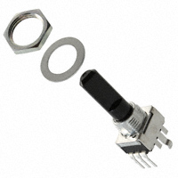

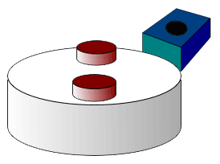
Planning: Electronics
Old: Limit switch
Hall effect
Potentiometer
Est. price | $50 | $10 | $10
Lifetime | Great | Infinite | Good
Setup | Manual | By design | Either
Compatibility | Either | Two designs | Either

Slide 7
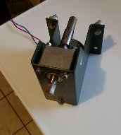
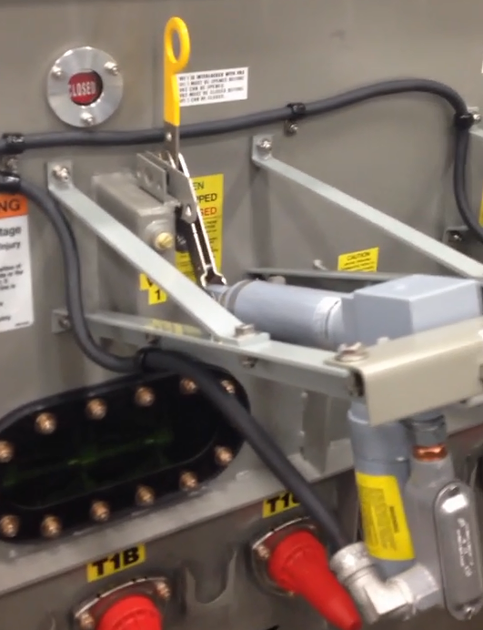
Planning: Motor Selection
Cheap: $80
Integrated gearbox
Already part of supply chain
Linear actuator assembly: $1000

Slide 8
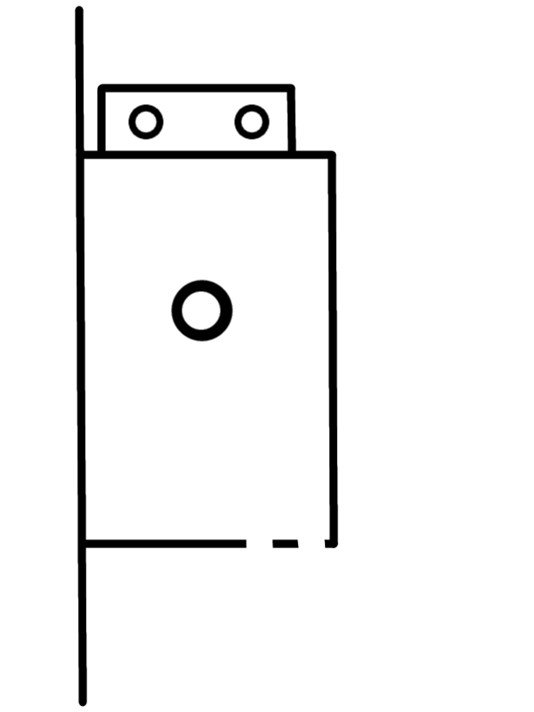
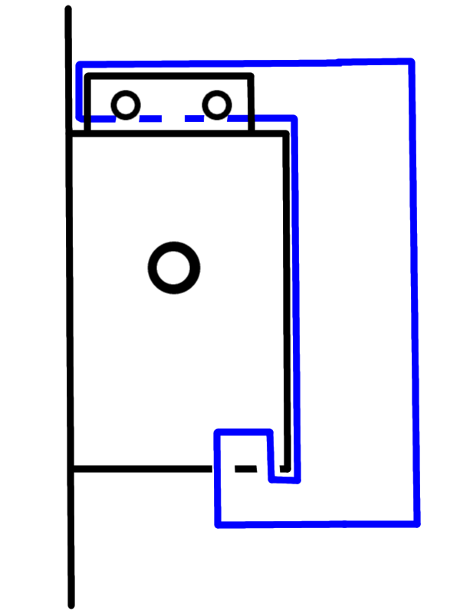
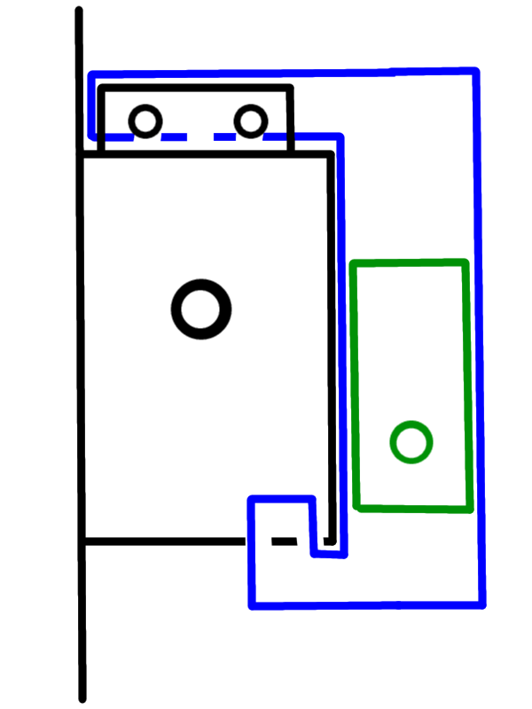
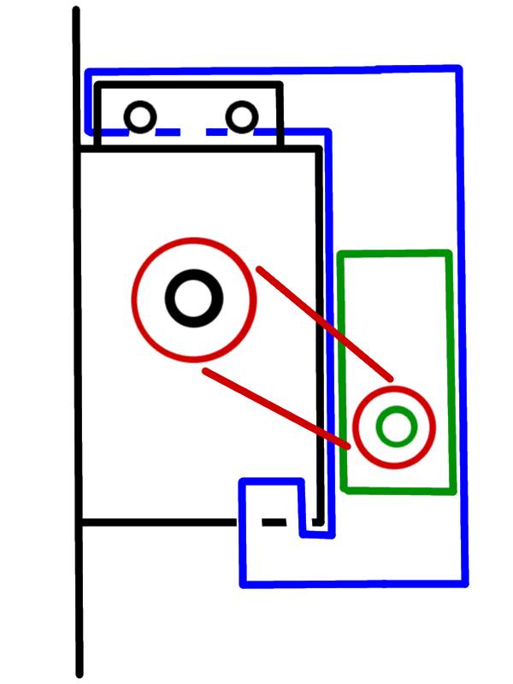
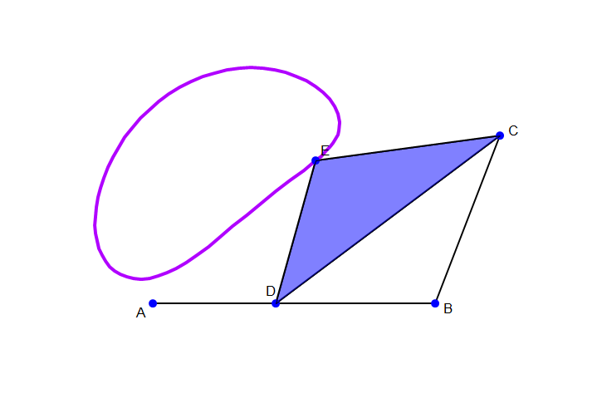
Planning: Shaft driving
Integrated gearbox
High torque to backdrive
Integrated gearbox
High torque to backdrive
4 Bar Linkage
Cheap to manufacture
Difficult to model torque and speed w.r.t. angle
4 Bar Linkage
Cheap to manufacture
Difficult to model torque and speed w.r.t. angle
Sprocket and Chain
Torque from motor and user increased by constant ratio
Cheap, but harder to install
Sprocket and Chain
Torque from motor and user increased by constant ratio
Cheap, but harder to install

Slide 9
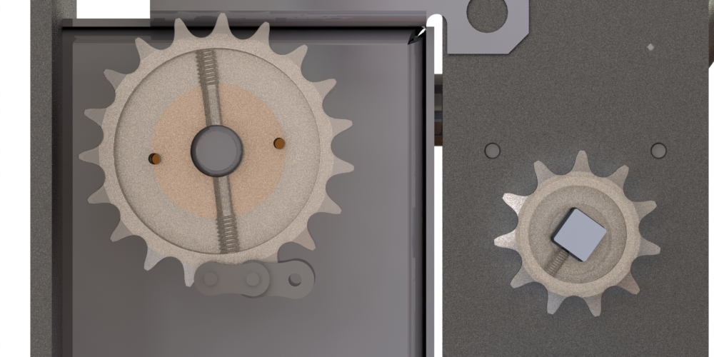
Planning: Sprockets
ANSI 40 Heavy Duty
Expected force:
F=T/R_{sprocket}
720in-lb/1.65in =424lbf
Capable of 4000lbf
Reduction:
11T and 19T
Max torque at motor decreased to 35ft-lb
Speed decrease

Slide 10
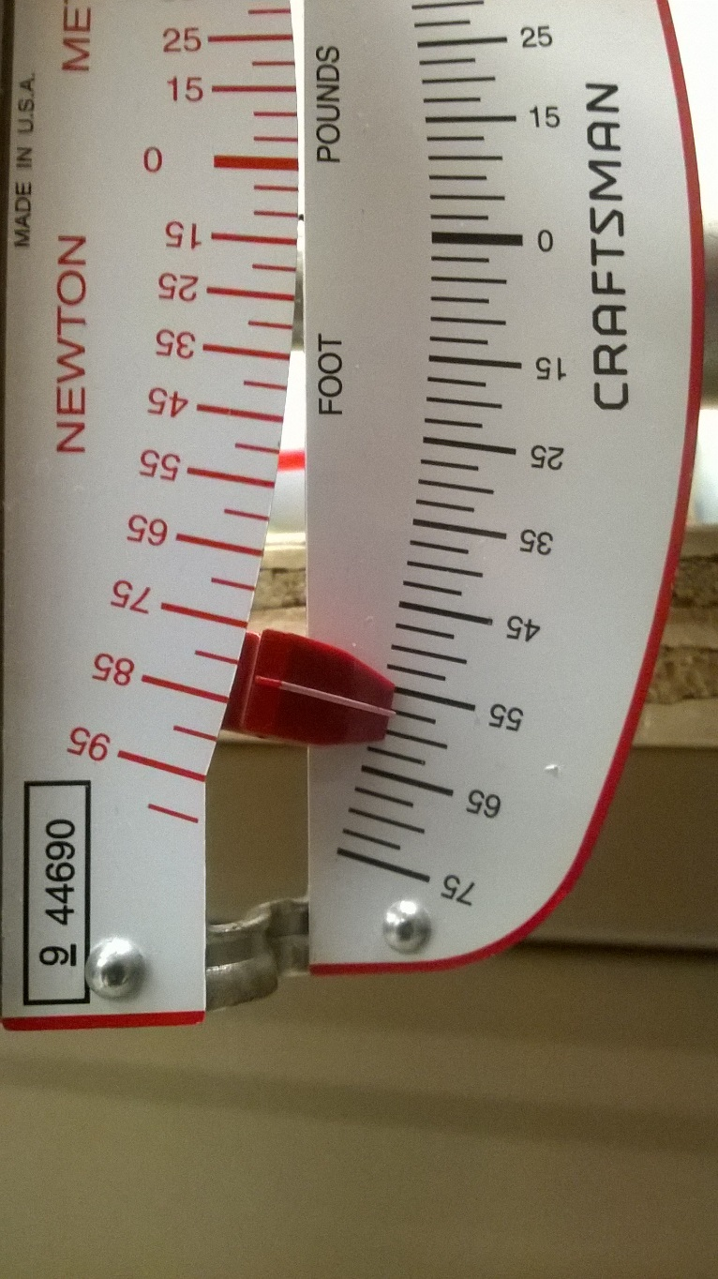
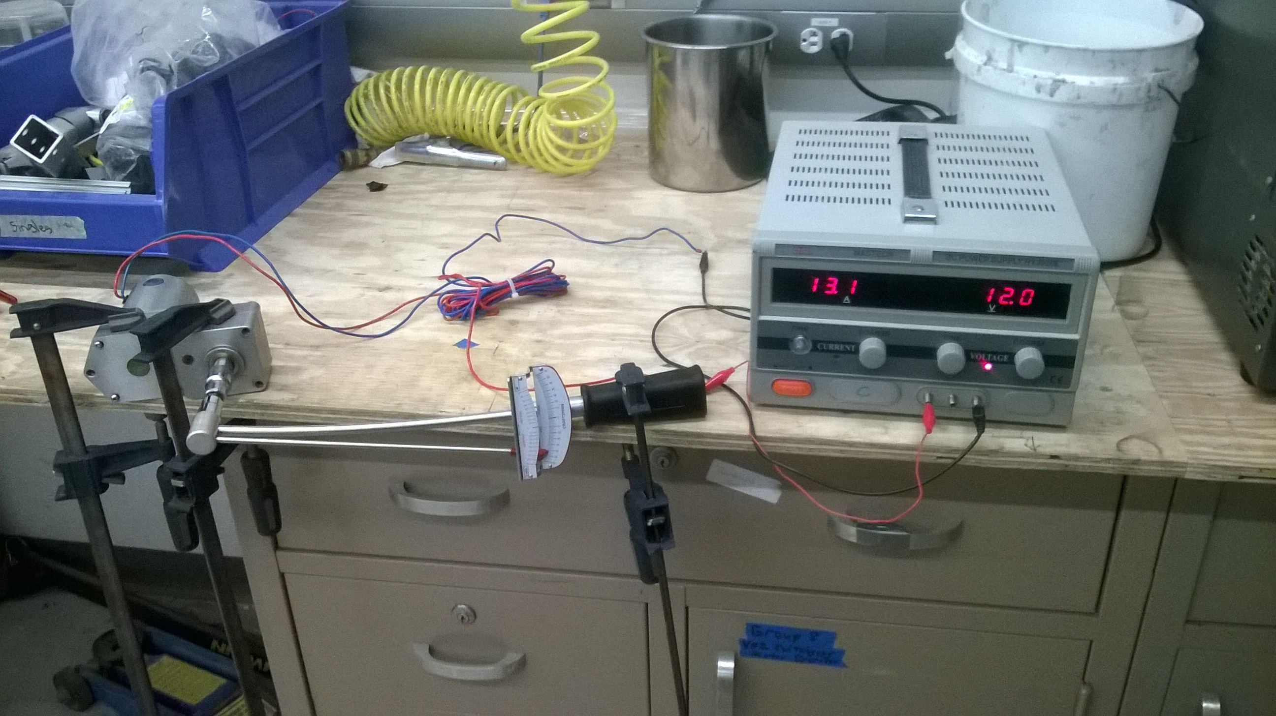

Testing: Motor

Slide 11
Testing: Motor Analysis

Slide 12
Testing: Motor Analysis

Slide 13
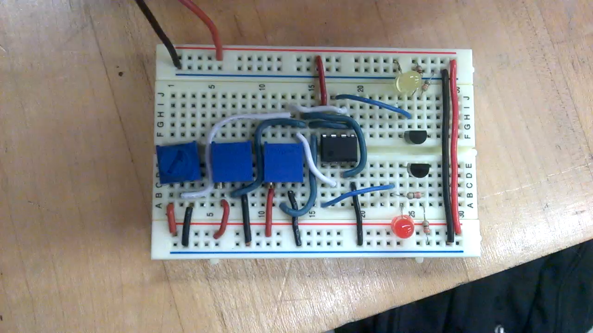
Testing: Demo potentiometer

Slide 14
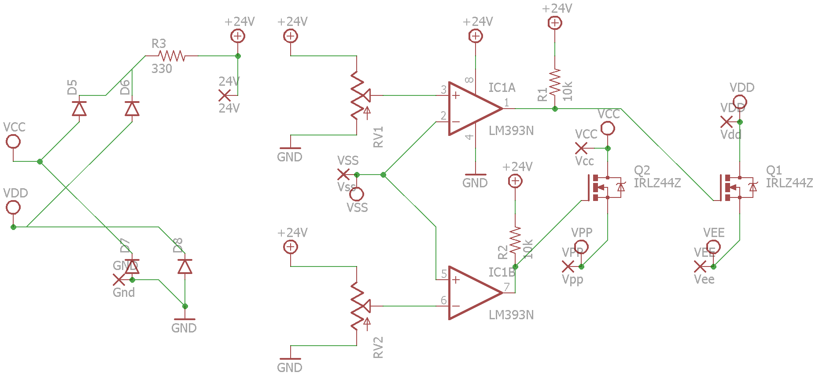
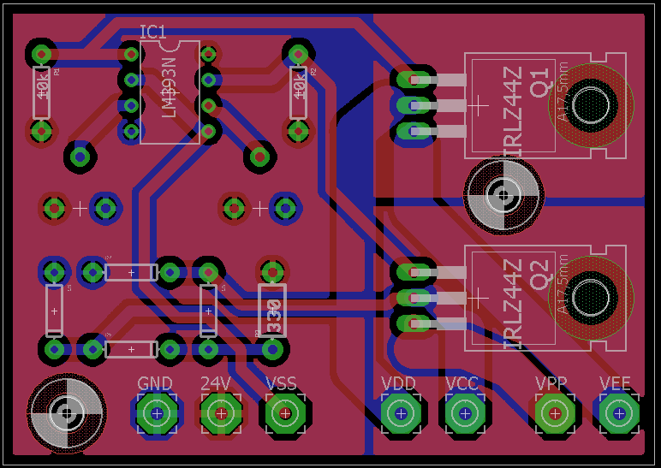
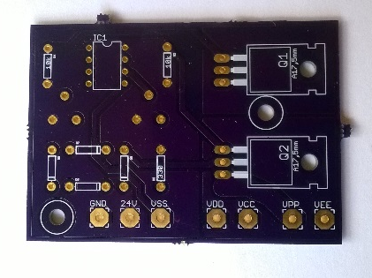
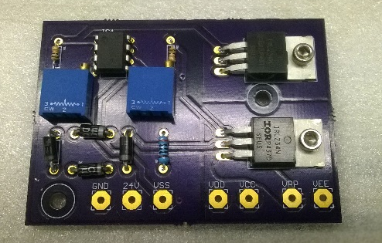


Building: Electronics - PCB Design

Slide 15
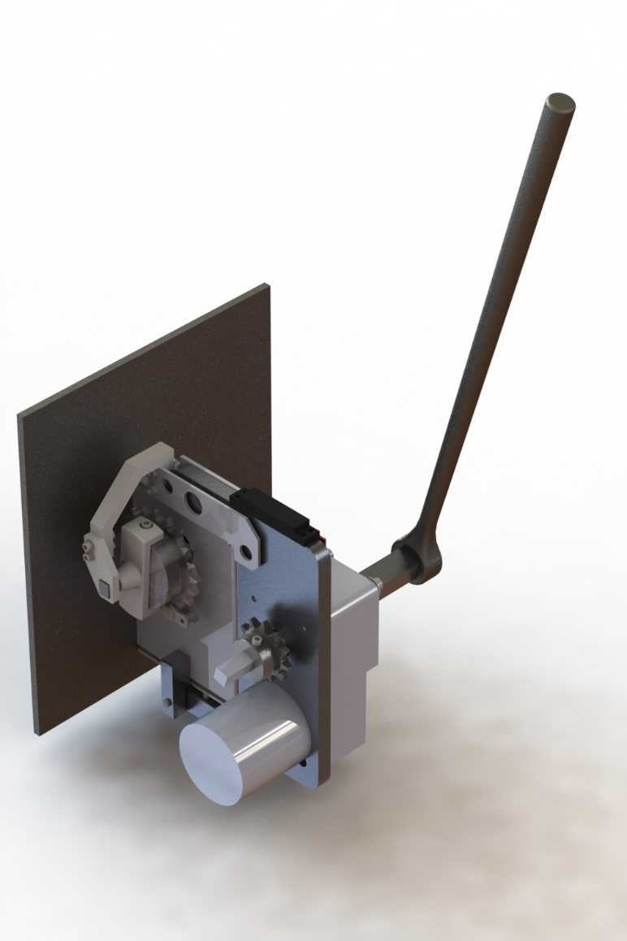
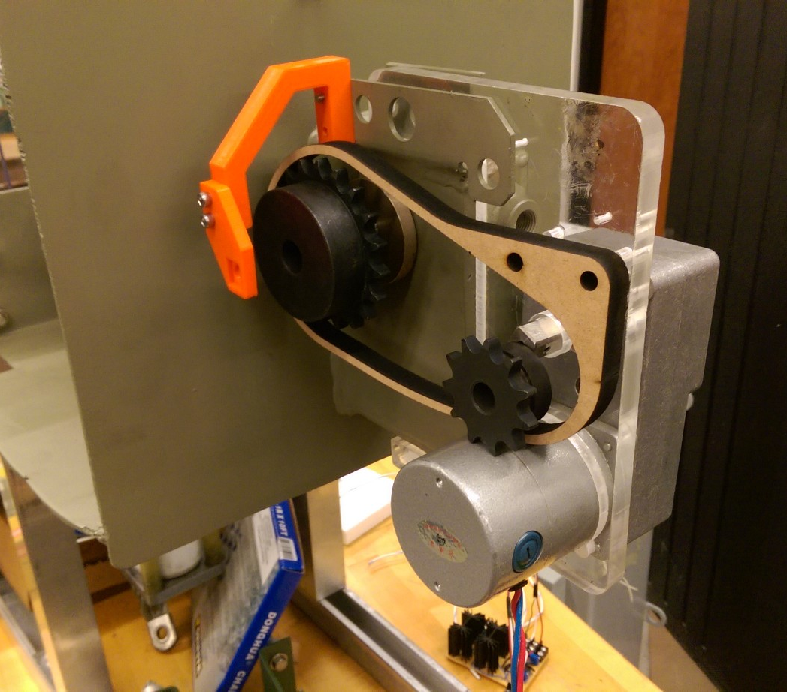
Building: First Mockup

Slide 16
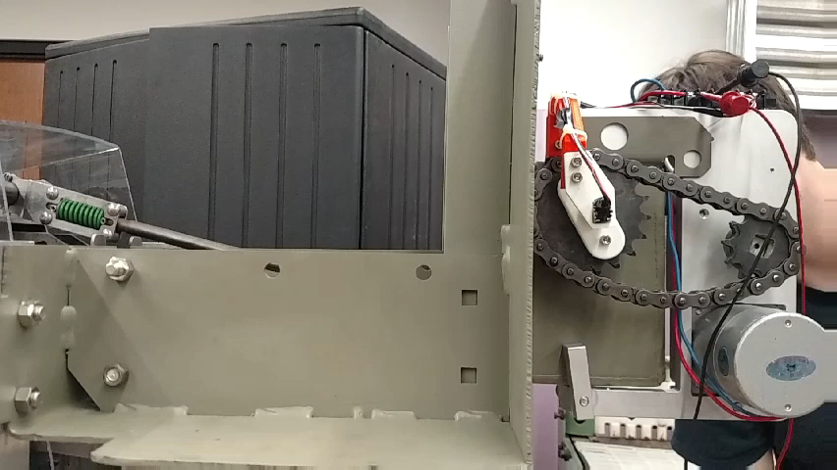
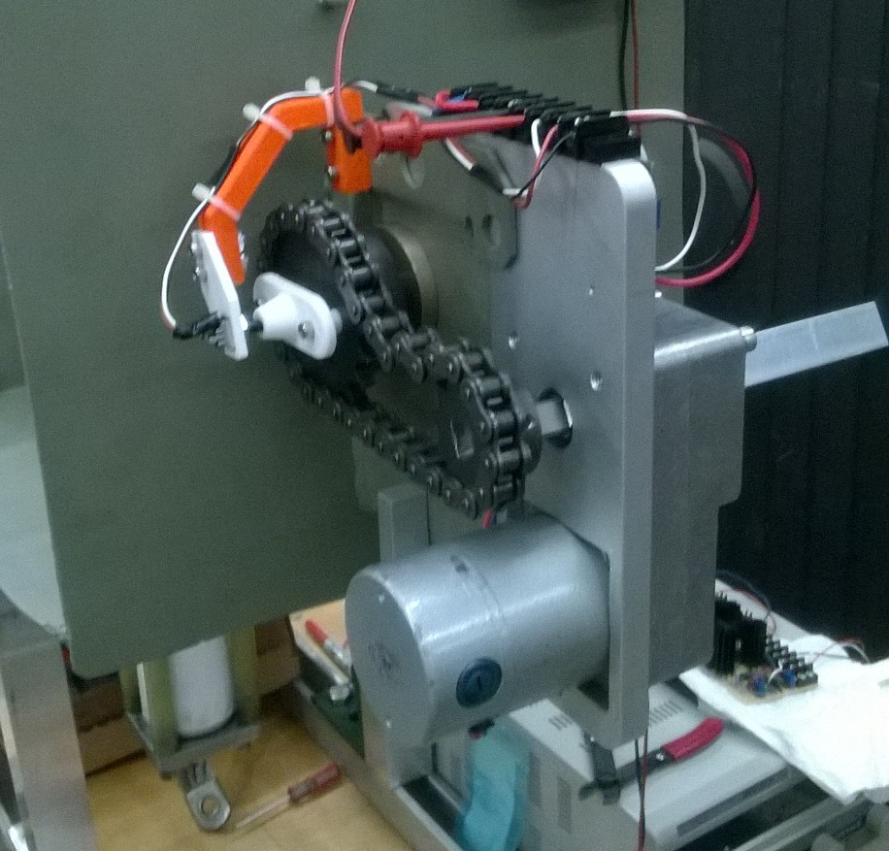
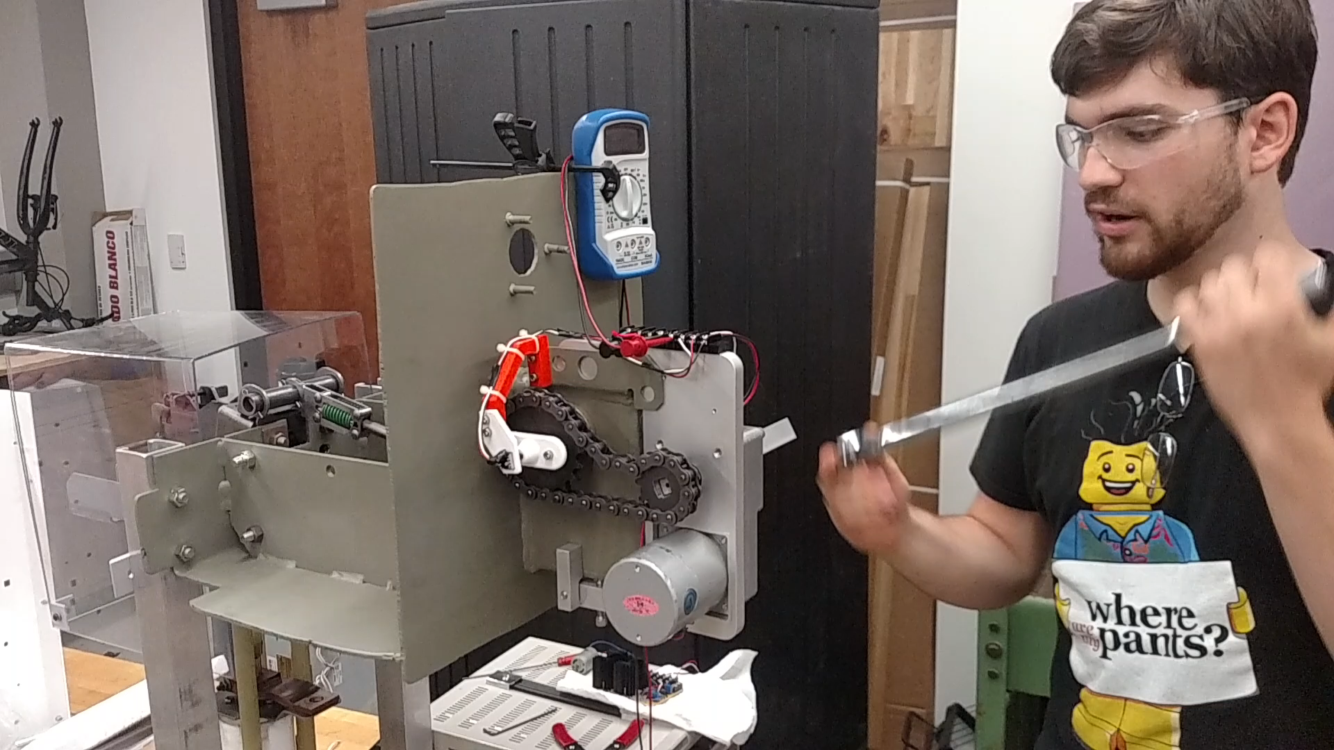

Building: Final Product

Slide 17
Conclusion
Minimum Requirements
Provide 60ft-lb of torque
Operate on 24V input
Minimum speed of 4 RPM
Less than 2° overtravel
Under $400
90ft-lb
18-30V
6.3RPM
Testing
$350 for 20+
Stretch Goals
Manual operation without the use of a pin
Use the same handle
Within 4” of all sides of switchgear case
Configurable to work with multiple angles of travel
Work on both sides
Reduced to 45ft-lb
Breaker bar
<3.5”
4°-296°
Mirror

Slide 18
Acknowledgements
John Guldan
Switchgear Engineer at Eaton
Contact at Eaton, always available
Thorin Tobiassen and Andy Holmes
Swanson Center for Product Innovation (SCPI)
Design/manufacturing consulting
Josh Brown
Electrical Engineer at Human Engineering Research Laboratories (HERL)
Mentor for general circuit and PCB design
Dr. Stephen Ludwick
Professor at Pitt
Director of Advanced Technology at Aerotech
Initial design brainstorming

Slide 19
Questions?
???

